Slide 1
Automatic Indexing
Indexing
Term selection and weight assignment
Conflation/Stemming
Thesaurus and phrases
References:
  Salton89, Chapter 9.7
  Baeza-Yates and Ribeiro-Neto Chapter 7.2.5
COMP 336 Dik Lun LEE Department of Computer Science, HKUST, Slide <number>

Slide 2
Helping Query Formulation
Most users cannot formulate keywords that are best for finding good results from a document
User’s vocabulary is different from that used by the document authors
  Causing terminology mismatch
COMP 336 Dik Lun LEE Department of Computer Science, HKUST, Slide <number>

Slide 3
Automatic Construction of “Thesaurus”
(in fact, sets of “similar” terms)
COMP 336 Dik Lun LEE Department of Computer Science, HKUST, Slide <number>

Slide 4
Term Similarity
A variety of full automatic thesaurus construction methods are available. A method based on term similarity is as follows:
Given a collection of documents (corpus), construct the vector representation of each document (e.g., term weights can be based on tfxidf
T₁ T₂ …. T_{t}
D₁ d₁₁ d₁₂ … d_{1t}
D₂ d₂₁ d₂₂ … d_{2t}
: : : :
: : : :
D_{n} d_{n1} d_{n2} … d_{nt}
COMP 336 Dik Lun LEE Department of Computer Science, HKUST, Slide <number>

Slide 5
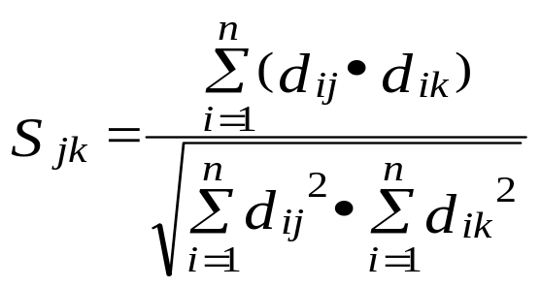
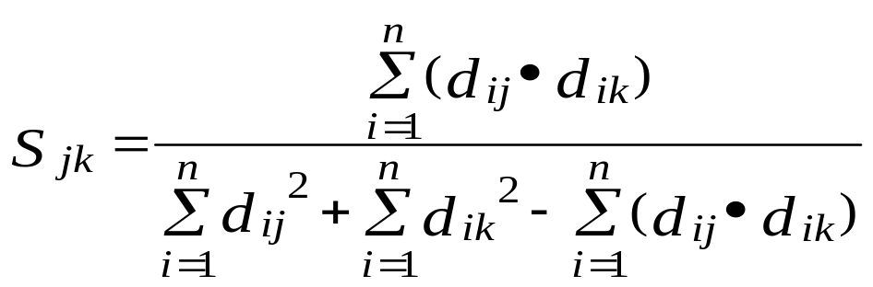
Term (Usage) Similarity
Compute the similarity between 2 pairs of terms:
  Two terms are similar if they appear in the same set of documents
  Similarity between terms T_{j} and T_{k} , S_{jk} can be computed using any similarity functions, such as cosine or Jaccard methods:
T₁ T₂ …. T_{t}
D₁ d₁₁ d₁₂ … d_{1t}
D₂ d₂₁ d₂₂ … d_{2t}
: : : :
: : : :
D_{n} d_{n1} d_{n2} … d_{nt}
S_{jk}
Questions:
Di,j are weights
Similarity indicates similarity in weights
COMP 336 Dik Lun LEE Department of Computer Science, HKUST, Slide <number>

Slide 6
Group Terms based on Term Similarity
The term similarities form a term-term similarity matrix. It is a symmetric matrix
From which thesaurus groups can be generated in different ways:
  single-link: two terms are put into the same group if their similarity exceeds a threshold
  complete-link: the similarity of each pair of words with a group must exceed a threshold
T₁ T₂ …. T_{t}
T₁ S₁₁ S₁₂ … S_{1t}
T₂ S₂₁ S₂₂ … S_{2t}
: : : :
: : : :
T_{t} S_{t1} S_{t2} … S_{tt}
COMP 336 Dik Lun LEE Department of Computer Science, HKUST, Slide <number>

Slide 7
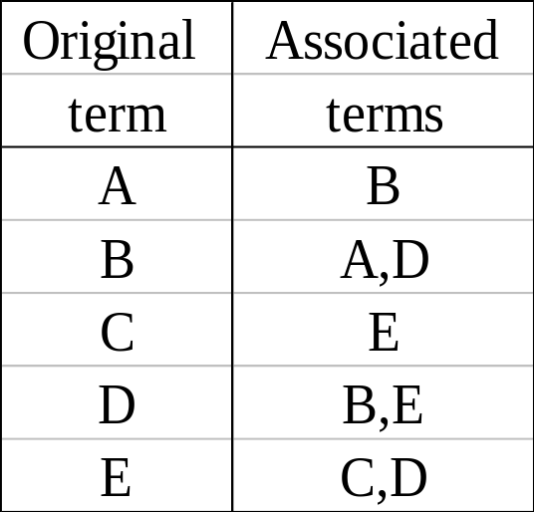
Application of Term Similarity -- An Example
The term-term similarity matrix of five terms, A, B, C, D, and E.
  assume similarity values are converted to binary with a threshold
A B C D E
A 1 1 0 0 0
B 1 1 0 1 0
C 0 0 1 0 1
D 0 1 0 1 1
E 0 0 1 1 1
Corresponding term associations: terms co-occur in at least 2 documents (for illustration purpose only)
COMP 336 Dik Lun LEE Department of Computer Science, HKUST, Slide <number>

Slide 8
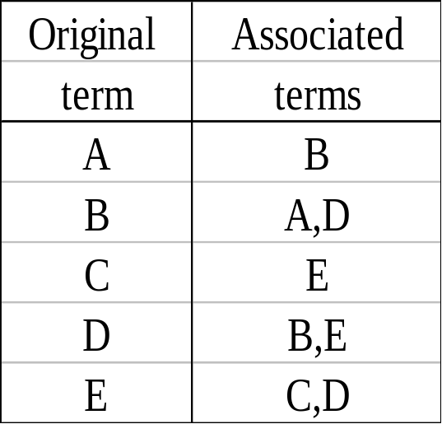
Thesaurus Use -- An Example
Query is expanded by adding the associated terms with weight 0.5 of the original term’s weight.
A=4
B=2
C=1
D=1
E=0
Add B=2
Add A=1,D=1
Add E =0.5
Add B=0.5, E=0.5
Add nothing
q =
A=5
B=4.5
C=1
D=2
E=1
q’ =
Original query won’t return documents containing only E, but the new query will.
COMP 336 Dik Lun LEE Department of Computer Science, HKUST, Slide <number>

Slide 9
Thesaurus -- Cost of Maintenance
The “thesaurus” only contains “co-occurring” terms in a corpus
The thesaurus may require rebuilding as result of user interaction with the system
  new queries for which the thesaurus is inadequate
  new user interests may appear which require new vocabulary terms
The thesaurus needs to accommodate collection growth
  completely regenerating the thesaurus is very expensive
COMP 336 Dik Lun LEE Department of Computer Science, HKUST, Slide <number>

Slide 10
Words vs. Phrases
Single term indexing has some problems
  Single terms are either too specific or too broad
  Single terms carry no context, hence may be ambiguous
Why phrases?
  Phrases are more specific in meaning
  Some phrases become meaningless when broken down into words
    Hong Kong cannot be derived from “Hong” or “Kong” alone
How to identify phrases?
  Maintain a phrase dictionary; is it possible?
  Derived from grammatical analysis; how accurate is it?
COMP 336 Dik Lun LEE Department of Computer Science, HKUST, Slide <number>

Slide 11
Term Phrase Formation
Term phrases are combination of terms with particular occurrence properties
  Do not rely on sophisticated grammatical analysis
  But can use some simple grammatical rules to enhance accuracy
  Are not “real” phrases as would be accepted by linguistics
Recall of a search can be improved by broadening the terms with associated terms
Precision may be improved by using specific terms or by using terms in combination with each other
  If a query is very narrow, adding another term may improve recall
  If a query term is very broad, adding another term may improve precision (e.g., combined by AND)
COMP 336 Dik Lun LEE Department of Computer Science, HKUST, Slide <number>

Slide 12
Phrase Head and Phrase Components
Select a term with high frequency (above a threshold) or negative discrimination value as the phrase head .
The other components of the phrase should be medium- or low- frequency terms with certain co-occurrence relationship with the phrase head (adjacent or a limited number of words away within a sentence).
Phrase will not contain common function words (stop list)
COMP 336 Dik Lun LEE Department of Computer Science, HKUST, Slide <number>

Slide 13
Identifying Phrase Heads
The text
  Effective retrieval systems are essential for people in need of information
Remove the function words
  Effective retrieval systems essential people need information
Choose the term phrase head
  Assume that high frequency words are: system, people, information
  and chosen as the phrase head
COMP 336 Dik Lun LEE Department of Computer Science, HKUST, Slide <number>

Slide 14
Identifying Phrase Components
Phrase heads are too general, we want to find phrase components that make the heads more specific
For example, for system, people, information, we want to see if we can find database systems, system engineering, American people, financial information, information system, etc.
Heuristics: Consecutive words are likely phrases …
COMP 336 Dik Lun LEE Department of Computer Science, HKUST, Slide <number>

Slide 15
Heuristics for Identifying Phrase Components
Heuristic 1: Heads and components must be adjacent
  Good: retrieval systems, systems essential, people need, need information
  Bad: essential people
  More restrictive but precise: will miss “effective system”
Effective retrieval systems essential people need information
Heuristic 2: Heads and components co-occur in sentence
  Good: effective systems, retrieval information
  Bad: system need, effective people, retrieval people, effective information, essential information
  more aggressive: generate good term “effective system”
  good for related words separated by grammatical structure: “The man driving the BMW is very rich”
COMP 336 Dik Lun LEE Department of Computer Science, HKUST, Slide <number>

Slide 16
Linguistic Rules for Identifying Phrase Components
Pure occurrence constraints may lead to some questionable phrases
Combine with linguistic analysis may be more effective
  Term phrase must conform to certain syntactic pattern
    adjective-noun, noun-noun
      Case1: retrieval systems, people need, need information
  Term phrases must occur within the same sentence units
    subject phrases, objective phrases
      Case 2: effective systems
Effective retrieval systems essential people need information
COMP 336 Dik Lun LEE Department of Computer Science, HKUST, Slide <number>

Slide 17
Term Phrase Formation -- Comments
The results did not show which one is really better than the other (more stringent or not); application dependent
May be useful to augment with the domain-specific knowledge
  high frequency transistor oscillator
  -> “high frequency oscillator”
Generating semantic interpretation is difficult
  time flies like an arrow
For IR system
  recognition of semantically identical but structurally different phrases during indexing; or
  generation of semantically equivalent phrases from what is specified in the query
COMP 336 Dik Lun LEE Department of Computer Science, HKUST, Slide <number>

Slide 18
Bigram and Trigrams
n-grams are taken as terms: Given “Terms are represented using bi-grams”
  Bigrams: “terms are”, “are represented”, “represented using”, “using bi”, “bi grams”
  Tri-grams: “Terms are represented”, “are represented using”, “represented using bi”, and “using bi grams”
COMP 336 Dik Lun LEE Department of Computer Science, HKUST, Slide <number>

Slide 19
Summary
Term selection
  Using a stop list
  Term frequency and document frequency (e.g., tf*idf weight must exceed a threshold)
  Based on discrimination value (e.g., must be positive)
Stemming
Thesaurus groups
  Term similarity based on term vectors
  improve recall for low frequency terms (using OR) or improve precision for high frequency terms (using AND)
Term phrases
  Combination of statistical methods (e.g., identifying high-frequency term heads) and grammar rules (e.g., accepting only AN and NN combinations)
COMP 336 Dik Lun LEE Department of Computer Science, HKUST, Slide <number>

